Slide 1

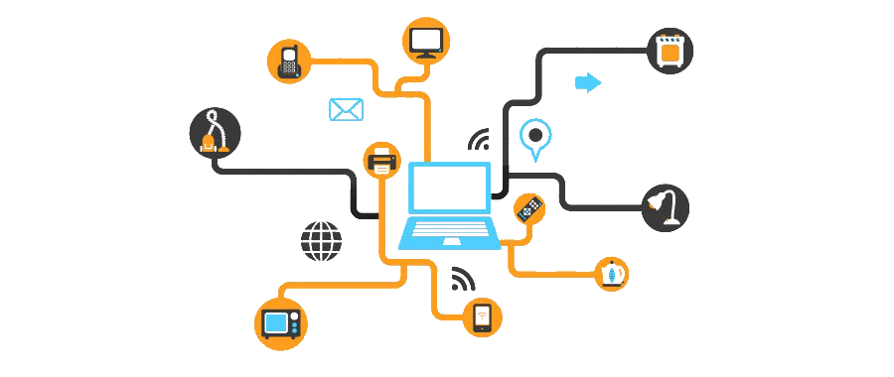

3130704
Digital Fundamentals
Module 1:
Fundamentals of Digital Systems and Logic families
Prof. Krunal D. Vyas
9601901005
krunal.vyas@darshan.ac.in

Slide 2
Topics to be covered
Logic Gates
Boolean Algebra
Number Systems
Codes
Logic Family Terminology

Slide 3
Logic Gates
Most basic logical unit of the digital system is gate circuit
Types of gate circuits are as follows
AND Gate
OR Gate
NOT Gate (Inverter)
NOR Gate
NAND Gate
XOR Gate
XNOR Gate

Slide 4


1. AND Gate
AND Gate has an output which is normally at logic level “0” and only goes “HIGH” to a logic level “1” when ALL of its inputs are at logic level “1”
2-input AND Gate
Logic Notation
A
$$C=A∙B$$
C
B
Truth Table
A | B | C
0 | 0 | 0
0 | 1 | 0
1 | 0 | 0
1 | 1 | 1

Slide 5


2. OR Gate
OR Gate or Inclusive-OR gate has an output which is normally at logic level “0” and only goes “HIGH” to a logic level “1” when one or more of its inputs are at logic level “1”.
2-input OR Gate
Logic Notation
A
$$C=A+B$$
C
B
Truth Table
A | B | C
0 | 0 | 0
0 | 1 | 1
1 | 0 | 1
1 | 1 | 1

Slide 6

3. NOT (Inverter) Gate
NOT gate has an output which is always opposite to input level.
Inverter Gate
Logic Notation
$$C=\overline{A} or C=A′$$
A
C
Truth Table
A | C
0 | 1
1 | 0

Slide 7

4. NOR Gate
NOR Gate is an OR gate followed by an inverter.
2-input NOR Gate
Logic Notation
A
$$C={\left(A+B\right)}^{′}$$
C
B
Truth Table
A | B | C
0 | 0 | 1
0 | 1 | 0
1 | 0 | 0
1 | 1 | 0

Slide 8

5. NAND Gate
NAND Gate is an AND gate followed by an inverter.
2-input NAND Gate
Logic Notation
A
$$C=(A∙B)′$$
C
B
Truth Table
A | B | C
0 | 0 | 1
0 | 1 | 1
1 | 0 | 1
1 | 1 | 0

Slide 9

6. Exclusive-OR (X-OR) Gate
X-OR gate that has 1 state when one and only one of its two inputs assumes a logic 1 state and has 0 state when all of its input are same.
Also known as anti-coincidence gate or inequality detector.
2-input XOR Gate
Logic Notation
A
$$C=A ⨁ B$$
C
B
Truth Table
A | B | C
0 | 0 | 0
0 | 1 | 1
1 | 0 | 1
1 | 1 | 0

Slide 10

7. Exclusive-NOR (X-NOR) Gate
X-NOR gate that has 1 state when all of its input are same and has 0 state when one of its input has 0 state and other input is 1 state.
Also known as equality detector.
2-input XNOR Gate
Logic Notation
A
$$C=A ⨀ B$$
C
B
Truth Table
A | B | C
0 | 0 | 1
0 | 1 | 0
1 | 0 | 0
1 | 1 | 1

Slide 11
NAND as Universal Gate
(AB)’
((AB)’)’ = AB
A
A
A’
B
NOT using NAND
AND using NAND
A’
A
(A’B’)’ = (A+B)
B
B’
OR using NAND

Slide 12
NOR as Universal Gate
(A+B)’
((A+B)’)’ = A+B
A
A
A’
B
NOT using NOR
OR using NOR
A’
A
(A’+B’)’ = AB
B
B’
AND using NOR

Slide 13
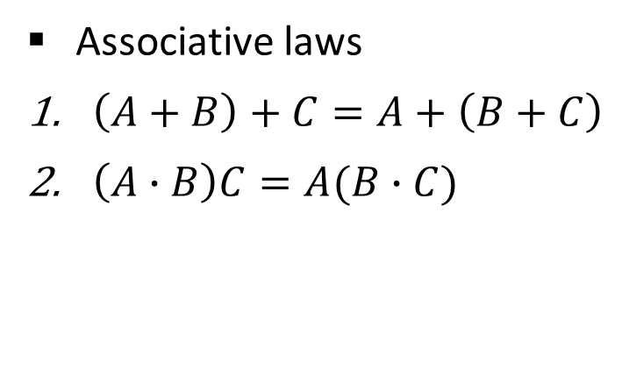
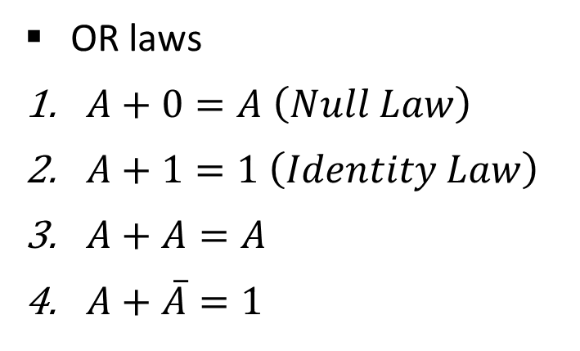
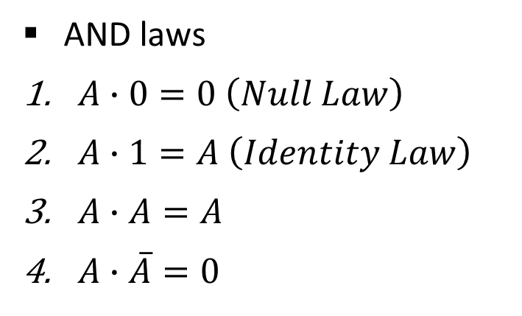
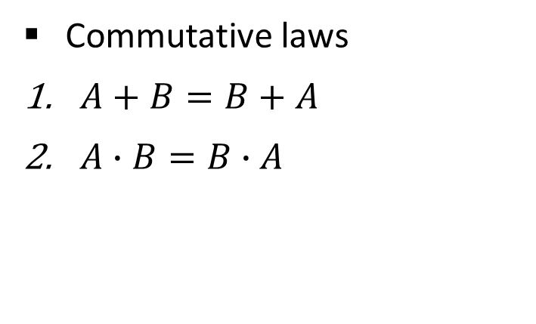
Boolean Algebra
AND laws
$A∙0=0 \left(Null Law\right)$
$A∙1=A \left(Identity Law\right)$
$A∙A=A$
$A∙\overline{A}=0$
OR laws
$A+0=A \left(Null Law\right)$
$A+1=1 \left(Identity Law\right)$
$A+A=A$
$A+\overline{A}=1$
Commutative laws
$A+B=B+A$
$A∙B=B∙A$
``

Slide 14
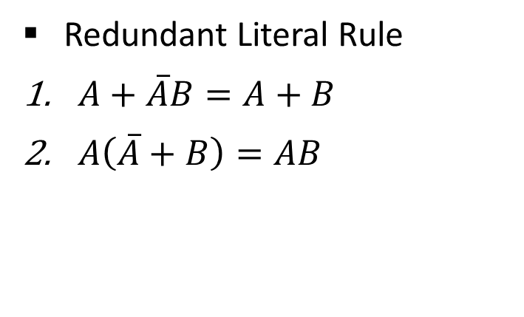
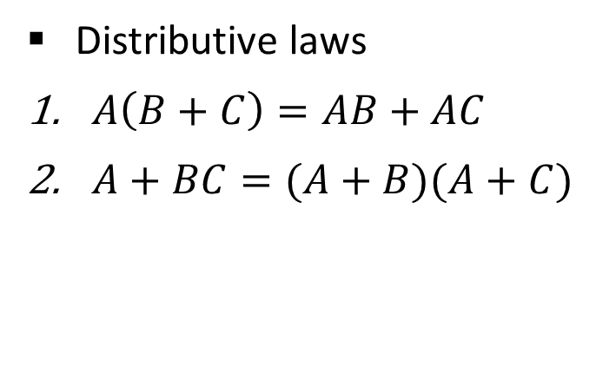
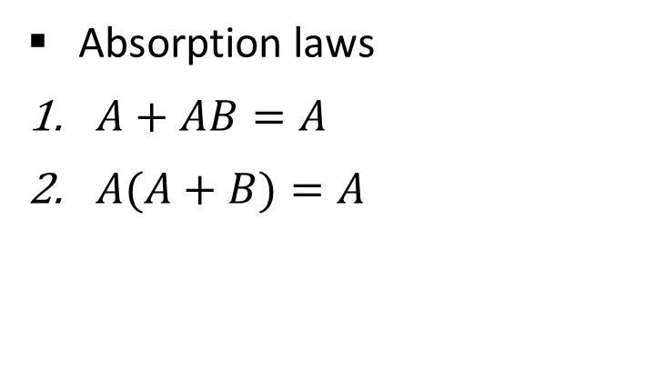

Boolean Algebra
Distributive laws
$A\left(B+C\right)=AB+AC$
$A+BC=(A+B)(A+C)$
Redundant Literal Rule
$A+\overline{A}B=A+B$
$A\left(\overline{A}+B\right)=AB$
Idempotent laws
$A∙A=A$
$A+A=A$
Absorption laws
$A+AB=A$
$A(A+B)=A$

Slide 15
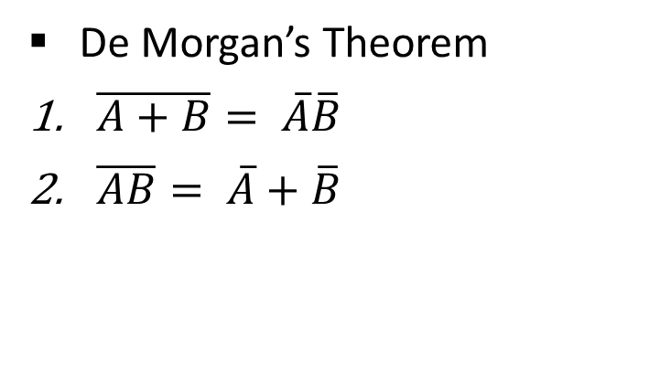
Boolean Algebra
De Morgan’s Theorem
$\overline{A+B}= \overline{A}\overline{B}$
$\overline{AB}= \overline{A}+\overline{B}$
Break the line change the sign

Slide 16
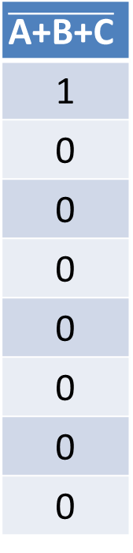
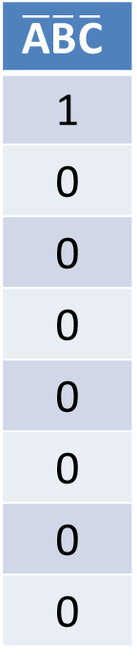
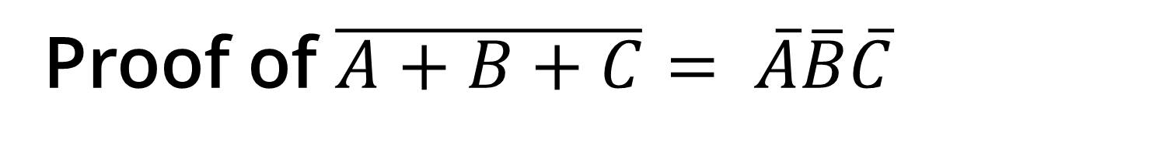
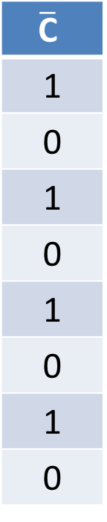
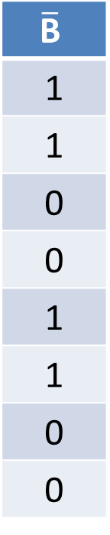
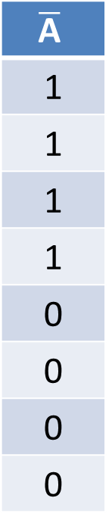
Proof of $\overline{A+B+C}= \overline{A}\overline{B}\overline{C}$
L.H.S.
R.H.S.
A
0
0
0
0
1
1
1
1
B
0
0
1
1
0
0
1
1
C
0
1
0
1
0
1
0
1
A+B+C
0
1
1
1
1
1
1
1
$$\overline{\text{A}\text{+}\text{B}\text{+}\text{C}}$$
1
0
0
0
0
0
0
0
$$\overline{\text{A}}$$
1
1
1
1
0
0
0
0
$$\overline{\text{B}}$$
1
1
0
0
1
1
0
0
$$\overline{\text{C}}$$
1
0
1
0
1
0
1
0
$$\overline{\text{A}}\overline{\text{B}}\overline{\text{C}}$$
1
0
0
0
0
0
0
0
From truth table, it is clearly visible that L.H.S. = R.H.S. Hence, the complement of a sum of variables is equal to the product of their individual complements.

Slide 17
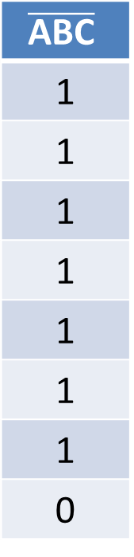
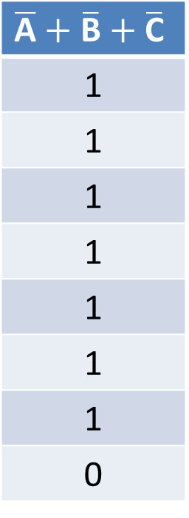
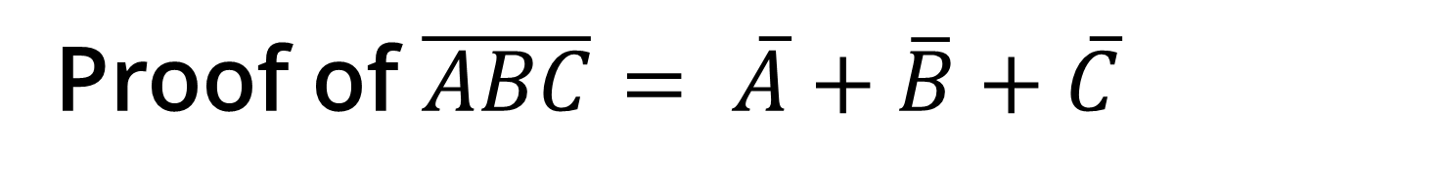
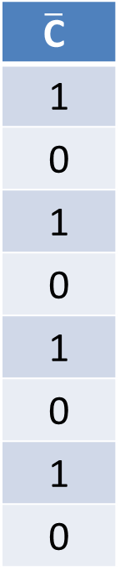
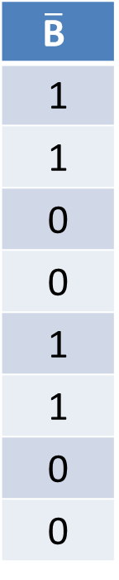

Proof of $\overline{ABC}= \overline{A}+\overline{B}+\overline{C}$
L.H.S.
R.H.S.
A
0
0
0
0
1
1
1
1
B
0
0
1
1
0
0
1
1
C
0
1
0
1
0
1
0
1
ABC
0
0
0
0
0
0
0
1
$$\overline{\text{ABC}}$$
1
1
1
1
1
1
1
0
$$\overline{\text{A}}$$
1
1
1
1
0
0
0
0
$$\overline{\text{B}}$$
1
1
0
0
1
1
0
0
$$\overline{\text{C}}$$
1
0
1
0
1
0
1
0
$$\overline{\text{A}}+\overline{\text{B}}+\overline{\text{C}}$$
1
1
1
1
1
1
1
0
From truth table, it is clearly visible that L.H.S. = R.H.S. Hence, the complement of a product of variables is equal to the sum of their individual complements.

Slide 18







Reducing Boolean Expression
Reduce the expression $f=A+B[AC+\left(B+\overline{C}\right)D]$
$$f=A+B[AC+\left(B+\overline{C}\right)D]$$
$$f=A+B[AC+BD+\overline{C}D]$$
(Distributive law)
$$f=A+BAC+BBD+B\overline{C}D$$
(Distributive law)
$$f=A+ABC+BD+B\overline{C}D$$
(A.A = A)
$$f=A(1+BC)+BD(1+\overline{C})$$
$$f=A+BD$$
(1 + A = 1)

Slide 19








Reducing Boolean Expression
Reduce the expression $f=A[B+\overline{C}(\overline{AB+A\overline{C}})]$
$$f=A[B+\overline{C}(\overline{AB+A\overline{C}})]$$
$$f=A[B+\overline{C}(\overline{AB}\overline{A\overline{C}})]$$
(DeMorgan’s law)
$$f=A[B+\overline{C}(\overline{A}+\overline{B})(\overline{A}+C)]$$
(DeMorgan’s law)
$$f=A[B+\overline{C}(\overline{A}\overline{A}+\overline{A}C+\overline{B}\overline{A}+\overline{B}C)]$$
(Distributive law)
$$f=A[B+\overline{C}\overline{A}+\overline{C}\overline{A}C+\overline{C}\overline{B}\overline{A}+\overline{C}\overline{B}C]$$
(Distributive law)
$$f=A[B+\overline{C}\overline{A}+0+\overline{C}\overline{B}\overline{A}+0]$$
(A.A’ = 0)
$$f=AB+A\overline{C}\overline{A}+A\overline{C}\overline{B}\overline{A}$$
(Distributive law)
$$f=AB+0+0$$
(A.A’ = 0)
$$f=AB$$

Slide 20



Exercise
$f=\left(\overline{A+\overline{BC}}\right)(A\overline{B}+ABC)$
$f=(B+BC)(B+\overline{B}C)(B+D)$
Show that $AB+A\overline{B}C+B\overline{C}=AC+B\overline{C}$
$$f=0$$
$$f=B$$

Slide 21
Number Systems
Unit – 1: Binary Systems & Logic Circuits Darshan Institute of Engineering & Technology

Slide 22
Common Number Systems
System | Base | Symbols | Used by Humans? | Used in Computers?
Decimal | 10 | 0, 1, … 9 | Yes | No
Binary | 2 | 0, 1 | No | Yes
Octal | 8 | 0, 1, … 7 | No | No
Hexa- decimal | 16 | 0, 1, … 9, A, B, … F | No | No

Slide 23
Quantities / Counting
Decimal | Binary | Octal | Hexa- decimal
0 | 0 | 0 | 0
1 | 1 | 1 | 1
2 | 10 | 2 | 2
3 | 11 | 3 | 3
4 | 100 | 4 | 4
5 | 101 | 5 | 5
6 | 110 | 6 | 6
7 | 111 | 7 | 7
Decimal | Binary | Octal | Hexa- decimal
8 | 1000 | 10 | 8
9 | 1001 | 11 | 9
10 | 1010 | 12 | A
11 | 1011 | 13 | B
12 | 1100 | 14 | C
13 | 1101 | 15 | D
14 | 1110 | 16 | E
15 | 1111 | 17 | F

Slide 24
Conversion among Bases
Possibilities
Example
Decimal
Octal
Binary
Hexadecimal
25₁₀ = 11001₂ = 31₈ = 19₁₆
Base

Slide 25
Decimal to Binary
Decimal
Binary
Technique
Divide by two, keep track of the remainder
First remainder is bit 0 (LSB, least-significant bit)
Second remainder is bit 1 and so on

Slide 26
Example (Decimal to Binary)
125₁₀ = ?₂
2
125
1
2
62
0
2
31
1
2
15
1
2
7
1
2
3
1
2
1
1
0
125₁₀ =
1111101₂

Slide 27
Example (Decimal to Binary)
0.6875₁₀ = ?₂
integer
fraction
0.6875 x 2 =
1.3750
1
+
0.3750
0.3750 x 2 =
0.7500
0
+
0.7500
0.7500 x 2 =
1.5000
1
+
0.5000
0.5000 x 2 =
1.0000
1
+
0.0000
0.6875₁₀ =
0.1011₂

Slide 28
Exercise
(32)₁₀ = ( )₂
(555)₁₀ = ( )₂
(12999)₁₀ = ( )₂
(157.63)₁₀ = ( )₂
(64.125)₁₀ = ( )₂

Slide 29
Binary to Decimal
Binary
Decimal
Technique
Multiply each bit by 2^{n}, where n is the “weight” of the bit
The weight is the position of the bit, starting from 0 on the right
Add the results

Slide 30
Example (Binary to Decimal)
1 0 1 0 1 1
1 x 2⁵
+
0 x 2⁴
+
1 x 2³
+
0 x 2²
+
1 x 2¹
+
1 x 2⁰
32
+
0
+
8
+
0
+
2
+
1
43₁₀
101011₂ =
43₁₀

Slide 31
Example (Binary to Decimal)
1 1 . 1 1
1 x 2¹
+
1 x 2⁰
+
1 x 2⁻¹
+
1 x 2⁻²
2
+
1
+
0.5
+
0.25
3.75₁₀
11.11₂ =
3.75₁₀

Slide 32
Exercise
(11011)₂ = ( )₁₀
(101101)₂ = ( )₁₀
(11101111)₂ = ( )₁₀
(110.011)₂ = ( )₁₀
(1001.0010)₂ = ( )₁₀

Slide 33
Decimal to Octal
Decimal
Octal
Technique
Divide by eight
Keep track of the remainder

Slide 34
Example (Decimal to Octal)
125₁₀ = ?₈
8
125
5
8
15
7
8
1
1
0
125₁₀ =
175₈

Slide 35
Example (Decimal to Octal)
0.6875₁₀ = ?₈
integer
fraction
0.6875 x 8 =
5.5000
5
+
0.5000
0.5000 x 8 =
4.0000
4
+
0.0000
0.6875₁₀ =
0.54₈

Slide 36
Exercise
(32)₁₀ = ( )₈
(555)₁₀ = ( )₈
(12999)₁₀ = ( )₈
(157.63)₁₀ = ( )₈
(64.125)₁₀ = ( )₈

Slide 37
Octal to Decimal
Octal
Decimal
Technique
Multiply each bit by 8^{n}, where n is the “weight” of the bit
The weight is the position of the bit, starting from 0 on the right
Add the results

Slide 38
Example (Octal to Decimal)
7 2 4
7 x 8²
+
2 x 8¹
+
4 x 8⁰
448
+
16
+
4
468₁₀
724₈ =
468₁₀

Slide 39
Example (Octal to Decimal)
4 3 . 2 5
4 x 8¹
+
3 x 8⁰
+
2 x 8⁻¹
+
5 x 8⁻²
32
+
3
+
0.25
+
0.0781
35.3281₁₀
43.25₈ =
35.3281₁₀

Slide 40
Exercise
(32)₈ = ( )₁₀
(555)₈ = ( )₁₀
(12333)₈ = ( )₁₀
(157.63)₈ = ( )₁₀
(64.125)₈ = ( )₁₀

Slide 41
Decimal to Hexa-Decimal
Decimal
Hexa-Decimal
Technique
Divide by 16
Keep track of the remainder

Slide 42
Example (Decimal to HexaDecimal)
1234₁₀ = ?₁₆
16
1234
2
16
77
13=D
16
4
4
0
1234₁₀ =
4D2₁₆

Slide 43
Exercise
(32)₁₀ = ( )₁₆
(555)₁₀ = ( )₁₆
(12999)₁₀ = ( )₁₆
(157.63)₁₀ = ( )₁₆
(64.125)₁₀ = ( )₁₆

Slide 44
Hexa-Decimal to Decimal
Hexa-Decimal
Decimal
Technique
Multiply each bit by 16^{n}, where n is the “weight” of the bit
The weight is the position of the bit, starting from 0 on the right
Add the results

Slide 45
Example (HexaDecimal to Decimal)
A B C
A x 16²
+
B x 16¹
+
C x 16⁰
10 x 16²
+
11 x 16¹
+
12 x 16⁰
2560
+
176
+
12
2748₁₀
ABC₁₆ =
2748₁₀

Slide 46
Exercise
(FA8)₁₆ = ( )₁₀
(9AC3)₁₆ = ( )₁₀
(1A74D)₁₆ = ( )₁₀
(1AC.9A)₁₆ = ( )₁₀
(ABC.5AC)₁₆ = ( )₁₀

Slide 47
Octal to Binary
Octal
Binary
Technique
Convert each octal digit to a 3-bit equivalent binary representation

Slide 48
Octal - Binary Table
Octal | Binary
0 | 000
1 | 001
2 | 010
3 | 011
4 | 100
5 | 101
6 | 110
7 | 111

Slide 49
Example (Octal to Binary)
705₈ = ?₂
7 0 5
111
000
101
705₈ =
111000101₂

Slide 50
Exercise
(463)₈ = ( )₂
(2056)₈ = ( )₂
(2057.64)₈ = ( )₂
(6543.04)₈ = ( )₂
(7476.47)₈ = ( )₂

Slide 51
Binary to Octal
Binary
Octal
Technique
Group bits in threes, starting on right
Convert to octal digits

Slide 52
Example (Binary to Octal)
1011010111₂ = ?₈
001
011
010
111
1
3
2
7
1011010111₂ =
1327₈

Slide 53
Exercise
(11011)₂ = ( )₈
(101101)₂ = ( )₈
(11101111)₂ = ( )₈
(110.011)₂ = ( )₈
(1001.0010)₂ = ( )₈

Slide 54
Hexa-Decimal to Binary
Hexa-Decimal
Binary
Technique
Convert each hexadecimal digit to a 4-bit equivalent binary representation

Slide 55
Hexa-Decimal to Binary
Hexa-Decimal | Binary | Hexa-Decimal | Binary
0 | 0000 | 8 | 1000
1 | 0001 | 9 | 1001
2 | 0010 | A | 1010
3 | 0011 | B | 1011
4 | 0100 | C | 1100
5 | 0101 | D | 1101
6 | 0110 | E | 1110
7 | 0111 | F | 1111

Slide 56
Example (Hexa-Decimal to Binary)
10AF₁₆ = ?₂
1 0 A F
0001
0000
1010
1111
10AF₁₆ =
1000010101111₂

Slide 57
Exercise
(FA8)₁₆ = ( )₂
(9AC3)₁₆ = ( )₂
(1A74D)₁₆ = ( )₂
(1AC.9A)₁₆ = ( )₂
(ABC.5AC)₁₆ = ( )₂

Slide 58
Binary to Hexa-Decimal
Binary
Hexa-Decimal
Technique
Group bits in fours, starting on right
Convert to hexadecimal digits

Slide 59
Example (Binary to Hexa-Decimal)
1011010111₂ = ?₁₆
0010
1101
0111
2
D
7
1011010111₂ =
2D7₁₆

Slide 60
Exercise
(11011)₂ = ( )₁₆
(101101)₂ = ( )₁₆
(11101111)₂ = ( )₁₆
(110.011)₂ = ( )₁₆
(1001.0010)₂ = ( )₁₆

Slide 61
Octal to Hexa-Decimal
Octal
Hexa-Decimal
Technique
Convert Octal to Binary
Regroup bits in fours from right
Convert Binary to Hexa-Decimal

Slide 62
Example (Octal to Hexa-Decimal)
1076₈ = ?₁₆
1 0 7 6
001
000
111
110
0010
0011
1110
2
3
E
1076₈ =
23E₁₆

Slide 63
Exercise
(463)₈ = ( )₁₆
(2056)₈ = ( )₁₆
(2057.64)₈ = ( )₁₆
(6543.04)₈ = ( )₁₆
(7476.47)₈ = ( )₁₆

Slide 64
Hexa-Decimal to Octal
Hexa-Decimal
Octal
Technique
Convert Hexa-Decimal to Binary
Regroup bits in three from right
Convert Binary to Octal

Slide 65
Example (Hexa-Decimal to Octal)
1F0C₁₆ = ?₈
1 F 0 C
0001
1111
0000
1100
000
001
111
100
001
100
0
1
7
4
1
4
1F0C₁₆ =
17414₈

Slide 66
Exercise
(FA8)₁₆ = ( )₈
(9AC3)₁₆ = ( )₈
(1A74D)₁₆ = ( )₈
(1AC.9A)₁₆ = ( )₈
(ABC.5AC)₁₆ = ( )₈

Slide 67
Signed Binary Numbers
Two ways of representing signed numbers:
1) Sign-magnitude form, 2) Complement form.
Most of computers use complement form for negative number notation.
1’s complement and 2’s complement are two different methods in this type.

Slide 68
1’s Complement
1’s complement of a binary number is obtained by subtracting each digit of that binary number from 1.
Example
1
1
1
1
1
1
1
.
1
1
-
1
1
0
1
-
1
0
1
.
0
1
0
0
1
0
0
1
0
.
1
0
(1’s complement of 1101)
(1’s complement of 101.01)

Slide 69
2’s Complement
2’s complement of a binary number is obtained by adding 1 to its 1’s complement.
Example
1
1
1
1
1
1
1
.
1
1
-
1
1
0
0
-
1
0
1
.
0
1
0
0
1
1
0
1
0
.
1
0
+
1
+
1
0
1
0
0
0
1
0
.
1
1
(2’s complement of 1100)
(2’s complement of 101.01)

Slide 70
Representation of negative number in 2’s complement form
Express -65.5 in 12 bit 2’s complement form.
2
65
1
1.0
0.5 x 2 =
2
32
0
So, result in 12-bit binary is as follows:
65.5₁₀ =
01000001.1000₂
2
16
0
For negative number, we have to convert this into 2’s complement form
2
8
0
2
4
0
-65.5₁₀ =
10111110.1000₂
2
2
0
2
1
1
0

Slide 71
Exercise
Express -45 in 8-bit 2’s complement form.
Express -73.75 in 12 bit 2’s complement form.

Slide 72
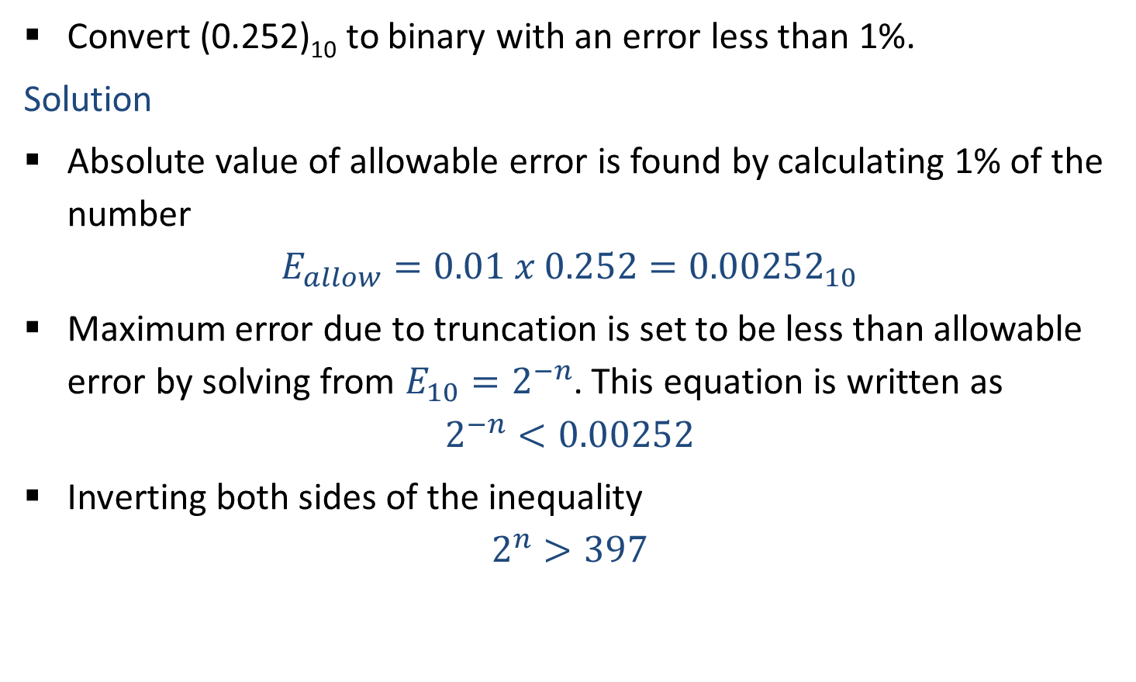
Accuracy in Binary Number Conversion
Convert (0.252)₁₀ to binary with an error less than 1%.
Solution
Absolute value of allowable error is found by calculating 1% of the number
$$E_{allow}=0.01 x 0.252={0.00252}_{10}$$
Maximum error due to truncation is set to be less than allowable error by solving from $E_{10}=2^{−n}$. This equation is written as
$$2^{−n}<0.00252$$
Inverting both sides of the inequality
$$2^{n}>397$$

Slide 73
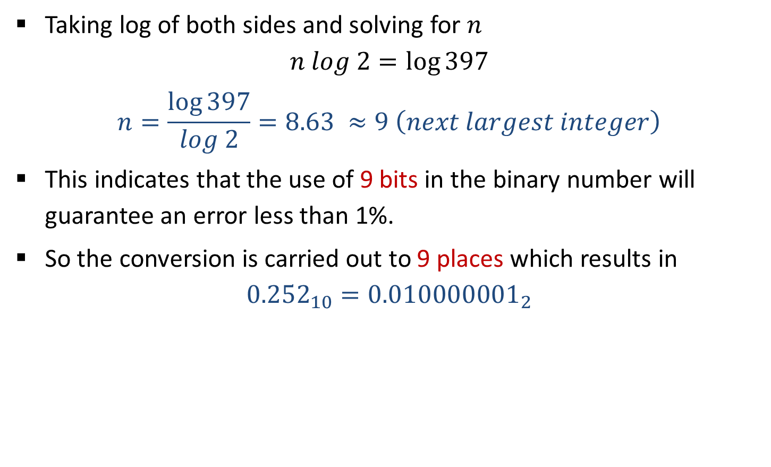
Accuracy in Binary Number Conversion
Taking log of both sides and solving for $n$
$$n log 2=\log{397}$$
$$n=\frac{\log{397}}{log 2}=8.63 ≈9 \left(next largest integer\right)$$
This indicates that the use of 9 bits in the binary number will guarantee an error less than 1%.
So the conversion is carried out to 9 places which results in
$${0.252}_{10}={0.010000001}_{2}$$

Slide 74
9’s Complement
9’s complement of a decimal number is obtained by subtracting each digit of that decimal number from 9.
Example
9
9
9
9
9
9
9
.
9
9
-
3
4
6
5
-
7
8
2
.
5
4
6
5
3
4
2
1
7
.
4
5
(9’s complement of 3465)
(9’s complement of 782.54)

Slide 75
10’s Complement
10’s complement of a decimal number is obtained by adding 1 to its 9’s complement.
Example
9
9
9
9
9
9
9
.
9
9
-
3
4
6
5
-
7
8
2
.
5
4
6
5
3
4
2
1
7
.
4
5
+
1
+
1
6
5
3
5
2
1
7
.
4
6
(10’s complement of 3465)
(10’s complement of 782.54)

Slide 76
Subtraction using 9’s complement
Obtain 9’s complement of subtrahend
Add the result to minuend and call it intermediate result
If carry is generated then answer is positive and add the carry to Least Significant Digit (LSD)
If there is no carry then answer is negative and take 9’s complement of intermediate result and place negative sign to the result.

Slide 77
Example
1) 745.81 – 436.62
7
4
5
.
8
1
7
4
5
.
8
1
-
4
3
6
.
6
2
9’s complement
+
5
6
3
.
3
7
3
0
9
.
1
9
1
3
0
9
.
1
8
+
1
3
0
9
.
1
9

Slide 78
Example
2) 436.62 - 745.81
4
3
6
.
6
2
4
3
6
.
6
2
-
7
4
5
.
8
1
9’s complement
+
2
5
4
.
1
8
-
3
0
9
.
1
9
6
9
0
.
8
0
9’s complement
-
3
0
9
.
1
9
As carry is not generated, so take 9’s complement of the intermediate result and add ‘ – ‘ sign to the result

Slide 79
Subtraction using 10’s complement
Obtain 10’s complement of subtrahend
Add the result to minuend
If carry is generated then ignore it and result itself is answer
If there is no carry then answer is negative and take 10’s complement of result and place negative sign to the result.

Slide 80
Example
1) 745.81 – 436.62
7
4
5
.
8
1
7
4
5
.
8
1
-
4
3
6
.
6
2
10’s complement
+
5
6
3
.
3
8
3
0
9
.
1
9
1
3
0
9
.
1
9
Ignore the carry

Slide 81
Example
2) 436.62 - 745.81
4
3
6
.
6
2
4
3
6
.
6
2
-
7
4
5
.
8
1
10’s complement
+
2
5
4
.
1
9
-
3
0
9
.
1
9
6
9
0
.
8
1
10’s complement
-
3
0
9
.
1
9
As carry is not generated, so take 10’s complement of the intermediate result and add ‘ – ‘ sign to the result

Slide 82
Binary Addition
Rules for binary addition
0 + 0 = 0
0 + 1 = 1
1 + 0 = 1
1
1
1
1
1
1
1 + 1 = 10 i.e. 0 with a carry of 1
1
1
0
1
.
1
0
1
+
0
1
1
1
.
0
1
1
1
0
1
0
1
.
0
0
0

Slide 83
Binary Subtraction
Rules for binary subtraction
0 – 0 = 0
1 – 1 = 0
1 – 0 = 1
1
0
1
1
1
0
0
1
1
0
1
0
.
0
1
0
0 – 1 = 1, with a borrow 1
1
-
0
1
1
1
.
1
1
1
0
0
1
0
.
0
1
1

Slide 84
Binary Multiplication
1 0 1 1 1
x
1 0 0 1 1
1
0
1
1
1
1
0
1
1
1
0
0
0
0
0
0
0
0
0
0
1
0
1
1
1
1
1
0
1
1
0
1
0
1

Slide 85
Binary Division
110
1 0 1 1 0 1
0
1
1
1
.
1
0 0 0
1 0 1
1
1 1 0
1 0 1
0
1 1 0
1 0 0
1
1 1 0
1 1
0
1 1 0
0 0 0

Slide 86
Subtraction using 1’s Complement
Obtain 1’s complement of subtrahend
Add the result to minuend and call it intermediate result
If carry is generated then answer is positive and add the carry to Least Significant Digit (LSD)
If there is no carry then answer is negative and take 1’s complement of intermediate result and place negative sign to the result.

Slide 87
Example
1) 68.75 – 27.50
6
8
.
7
5
1
0
0
0
0
0
0
1
.
1
1
0
0
1
0
0
0
0
-
2
7
1
1
1
.
0
1
1
1
.
5
0
1’s complement
+
4
1
.
2
5
0
1
0
1
0
1
+
1
0
0
.
0
0
1
1
+
1
0
0
1
1
0
0
1
0
.
0
1
0
0

Slide 88
Example
2) 43.25 - 89.75
4
3
.
2
5
0
0
1
1
1
0
1
0
.
0
1
0
0
0
0
0
1
0
-
8
9
1
1
1
.
0
0
1
1
.
7
5
1’s complement
+
4
6
.
5
0
1
0
1
0
0
1
-
1
0
.
0
1
1
1
1’s complement
0
1
0
1
1
0
0
1
.
1
0
0
0
As carry is not generated, so take 1’s complement of the intermediate result and add ‘ – ‘ sign to the result

Slide 89
Subtraction using 2’s Complement
Obtain 2’s complement of subtrahend
Add the result to minuend
If carry is generated then ignore it and result itself is answer
If there is no carry then answer is negative and take 2’s complement of result and place negative sign to the result.

Slide 90
Example
1) 68.75 – 27.50
6
8
.
7
5
1
0
0
0
0
0
0
1
.
1
1
0
0
1
0
0
0
0
-
2
7
1
1
1
.
1
0
0
0
.
5
0
2’s complement
+
4
1
.
2
5
0
1
0
1
0
1
+
1
0
0
.
0
1
0
0
Ignore Carry bit
0
1
0
1
0
1
0
0
.
0
1
0
0

Slide 91
Example
2) 43.25 - 89.75
4
3
.
2
5
0
0
1
1
1
0
1
0
.
0
1
0
0
0
0
0
1
0
-
8
9
1
1
1
.
0
1
0
0
.
7
5
2’s complement
+
4
6
.
5
0
1
0
1
0
0
1
-
1
0
.
1
0
0
0
2’s complement
0
1
0
1
1
0
0
1
.
1
0
0
0
As carry is not generated, so take 2’s complement of the intermediate result and add ‘ – ‘ sign to the result

Slide 92
Binary Codes
Unit – 1: Binary Systems & Logic Circuits Darshan Institute of Engineering & Technology

Slide 93
8421 BCD Code (Natural BCD Code)
Each decimal digit, 0 through 9, is coded by 4-bit binary number
8, 4, 2 and 1 weights are attached to each bit
BCD code is weighted code
1010, 1011, 1100, 1101, 1110 and 1111 are illegal codes
Less efficient than pure binary
Arithmetic operations are more complex than in pure binary
Example
Decimal
1 4
BCD
0001
0100
Binary
1110

Slide 94
Binary Codes
Decimal | Binary | BCD
0 | 0 | 0000
1 | 1 | 0001
2 | 10 | 0010
3 | 11 | 0011
4 | 100 | 0100
5 | 101 | 0101
6 | 110 | 0110
7 | 111 | 0111
Decimal | Binary | BCD
8 | 1000 | 1000
9 | 1001 | 1001
10 | 1010 | 0001 0000
11 | 1011 | 0001 0001
12 | 1100 | 0001 0010
13 | 1101 | 0001 0011
14 | 1110 | 0001 0100
15 | 1111 | 0001 0101

Slide 95
BCD Addition
2
5
0
0
1
0
0
1
0
1
+
1
3
+
0
0
0
1
0
0
1
1
3
8
0
0
1
1
1
0
0
0
No carry, no illegal code. So, this is the correct sum.

Slide 96
BCD Addition
679.6
0110
0111
1001
.0110
+
536.8
+
0101
0011
0110
.1000
1216.4
1011
1010
1111
.1110
All are illegal codes
+0110
+0110
+0110
+.0110
Add 0110 to each
10001
10000
10101
1.0100
Propagate carry
+
1
+
+
1
1
+
1
0001
0010
0001
0110
.0100
Corrected Sum

Slide 97
BCD Subtraction
3
8
0
0
1
1
1
0
0
0
-
1
5
-
0
0
0
1
0
1
0
1
2
3
0
0
1
0
0
0
1
1
No borrow. So, this is the correct difference.

Slide 98
BCD Subtraction
206.7
0010
0000
0110
.0111
-
147.8
-
0001
0100
0111
.1000
0000
1011
1110
.1111
Borrows are present
58.9
-0110
-0110
-.0110
Subtract 0110
0101
1000
.1001
Corrected difference

Slide 99
Excess Three (XS-3) Code
Excess Three Code = 8421 BCD + 0011(3)
XS-3 code is non-weighted BCD code
Also known as self complementing code
0000, 0001, 0010, 1101, 1110 and 1111 are illegal codes
Example
Decimal
1 4
BCD
0001
0100
XS-3
0100
0111

Slide 100
XS-3 Addition
3
7
0
1
1
0
1
0
1
0
+
2
8
+
0
1
0
1
1
0
1
1
6
5
1
0
1
1
1
0
1
0
1
+
Propagate carry to next group
1
Add 0011 to group which generated carry
Subtract 0011 to group which do not generated carry
1
1
0
0
0
1
0
1
-
0
0
1
1
+
0
0
1
1
1
0
0
1
1
0
0
0

Slide 101
XS-3 Addition
247.6
0101
0111
1010
.1001
+
359.4
+
0110
1000
1100
.0111
607.0
1011
1111
10110
1.0000
Carry generated
+
+
1
1
Propagate carry
Add 0011 to group which generated carry
Subtract 0011 to group which do not generated carry
1011
10000
0111
.0000
+
1
1100
0000
0111
.0000
- 0011
+0011
+0011
+.0011
1001
0011
1010
.0011
Corrected Sum in XS-3

Slide 102
XS-3 Subtraction
267
0101
1001
1010
-
175
-
0100
1010
1000
092
0000
1111
0010
+0011
-0011
+0011
Subtract 0011 to group which generated borrow
Add 0011 to group which do not generated borrow
0011
1100
0101

Slide 103
XS-3 Subtraction
57.6
1000
1010
.1001
-
27.8
-
0101
1010
.1011
29.8
0010
1111
.1110
+0011
-0011
-.0011
Subtract 0011 to group which generated borrow
Add 0011 to group which do not generated borrow
0101
1100
.1011

Slide 104
Gray Code
Only one bit changes between each pair of successive code words (Unit distance code).
Gray code is a reflected code.
Gray codes are designed recursively using following rules:
1-bit Gray code has two code words, 0 and 1.
The first 2^{n} code words of an (n+1)-bit Gray code equal the code words of n-bit gray code, written in order with a leading 0 appended.
The last 2^{n} code words of an (n+1)-bit Gray code equal the code words of n-bit gray code, but written in reverse order with a leading 1 appended.

Slide 105
Gray Code |  |  |  | Decimal | 4-bit Binary
1-bit | 2-bit | 3-bit | 4-bit
0 | 0 0 | 0 0 0 | 0 0 0 0 | 0 | 0000
1 | 0 1 | 0 0 1 | 0 0 0 1 | 1 | 0001
 | 1 1 | 0 1 1 | 0 0 1 1 | 2 | 0010
 | 1 0 | 0 1 0 | 0 0 1 0 | 3 | 0011
 |  | 1 1 0 | 0 1 1 0 | 4 | 0100
 |  | 1 1 1 | 0 1 1 1 | 5 | 0101
 |  | 1 0 1 | 0 1 0 1 | 6 | 0110
 |  | 1 0 0 | 0 1 0 0 | 7 | 0111
 |  |  | 1 1 0 0 | 8 | 1000
 |  |  | 1 1 0 1 | 9 | 1001
 |  |  | 1 1 1 1 | 10 | 1010
 |  |  | 1 1 1 0 | 11 | 1011
 |  |  | 1 0 1 0 | 12 | 1100
 |  |  | 1 0 1 1 | 13 | 1101
 |  |  | 1 0 0 1 | 14 | 1110
 |  |  | 1 0 0 0 | 15 | 1111

Slide 106



Binary to Gray Conversion
Conversion of n-bit Binary number (B) to Gray Code (G) is as follows:
Example: Convert (1001)₂ to Gray Code.
$$G_{n}=B_{n}$$ | $$G_{n−1}=B_{n}⨁{ B}_{n−1}$$ | $$G_{n−2}=B_{n−1}⨁{ B}_{n−2}…$$ | $$G_{1}=B_{2}⨁{ B}_{1}$$
Binary
1
$$⨁$$
0
$$⨁$$
0
$$⨁$$
1
Gray
1
1
0
1

Slide 107



Gray to Binary Conversion
Conversion of n-bit Gray Code (G) to Binary Number (B) is as follows:
Example: Convert Gray code 1101 to Binary.
$$B_{n}=G_{n}$$ | $$B_{n−1}=B_{n}⨁{ G}_{n−1}$$ | $$B_{n−2}=B_{n−1}⨁{ G}_{n−2}…$$ | $$B_{1}=B_{2}⨁{ G}_{1}$$
Gray
1
1
0
1
$$⨁$$
$$⨁$$
$$⨁$$
Binary
1
0
0
1

Slide 108
Error-Detecting Codes
Noise can alter or distort the data in transmission.
The 1s may get changed to 0s and 0s to 1s.
Because digital systems must be accurate to the digit, errors can pose a serious problem.
Single bit error should be detect & correct by different schemes.
Parity, Check Sums and Block Parity are the examples of error detecting code.

Slide 109
Parity
Parity bit is the simplest technique.
There are two types of parity – Odd parity and Even parity.
For odd parity, the parity is set to a 0 or a 1 at the transmitter such that the total number of 1 bits in the word including the parity bit is an odd number.
For even parity, the parity is set to a 0 or a 1 at the transmitter such that the total number of 1 bits in the word including the parity bit is an even number.
For example, 0110 binary number has “1” as Odd parity and “0” as even parity.

Slide 110
Parity
Detect a single-bit error but can not detect two or more errors within the same word.
In any practical system, there is always a finite probability of the occurrence of single error.
E.g. In an even-parity scheme, code 10111001 is erroneous because number of 1s is odd(5), while code 11110110 is error free because number of 1s is even(6).

Slide 111
Check Sums
Simple parity can not detect two errors within the same word.
Added to the sum of the previously transmitted words
At the transmission, the check sum up to that time is sent to the receiver.
The receiver can check its sum with the transmitted sum.
If the two sums are the same, then no errors were detected at the receiver end.
If there is an error, the receiving location can ask for retransmission of the entire data.
This type of transmission is used in teleprocessing system.

Slide 112
Block Parity
01011011
10010101
01101110
11010011
10001101
01110111
0
1
0
0
1
1
0
01011011
10010101
01100110
11010011
10001101
01110111
0
1
0
0
1
1
0
01011011
10010101
01101110
10000011
10001101
01110111
0
1
0
0
1
1
0
01110110
01110110
01110110
Parity Row
Parity Column

Slide 113
Error Correcting Code
7-bit Hamming Code is widely used error correcting code, containing 4 bits of data and 3 bits of even parity.
Pattern: P₁ P₂ D₃ P₄ D₅ D₆ D₇
Group-1: P₁D₃D₅D_{7,} Group-2: P₂D₃D₆D_{7,} Group-3: P₄D₅D₆D₇
Example: Data = 1101
P₁ P₂ D₃ P₄ D₅ D₆ D₇ = P₁ P₂ 1 P₄ 1 0 1
P₁ D₃ D₅ D₇ = 1 1 1 1
P₂ D₃ D₆ D₇ = 0 1 0 1
P₄ D₅ D₆ D₇ = 0 1 0 1
7-bit Hamming Code is 1 0 1 0 1 0 1

Slide 114
Error Correcting Code
How to detect error?
Example: Received data = 1001001
P₁ P₂ D₃ P₄ D₅ D₆ D₇ = 1 0 0 1 0 0 1
P₁ D₃ D₅ D₇ = 1 0 0 1 (No Error)
P₂ D₃ D₆ D₇ = 0 0 0 1 (Error)
P₄ D₅ D₆ D₇ = 1 0 0 1 (No Error)
The error word is 0 1 0 = 2₁₀.
Complement the 2nd bit (from left).
Correct code is 1 1 0 1 0 0 1

Slide 115
Digital IC Specification
Threshold voltage
Propagation Delay
Power dissipation
Fan-in
Fan-out
Voltage & Current parameters
Noise Margin
Operating Temperatures
Speed power products

Slide 116
TTL v/s CMOS v/s ECL
Characteristic | TTL | CMOS | ECL
Power Input | Moderate | Low | Moderate-High
Frequency limit | High | Moderate | Very high
Circuit density | Moderate-high | High-very high | Moderate
Circuit types per family | High | High | Moderate
Logic Family | Propagation delay time (ns) | Power dissipation per gate (mW) | Noise Margin (V) | Fan-in | Fan-out | Cost
TTL | 9 | 10 | 0.4 | 8 | 10 | Low
CMOS | <50 | 0.01 | 5 | 10 | 50 | Low
ECL | 1 | 50 | 0.25 | 5 | 10 | High

Slide 117
Transistor Transistor Logic (TTL)
Dependence on transistors alone to perform basic logic operations.
Most popular logic family.
Most widely useful bipolar digital IC family.
The TTL uses transistors operating in saturated mode.
It is the fastest of the saturated logic families.
Good speed, low manufacturing cost, wide range of circuits, and the availability in SSI and MSI are its merits.

Slide 118
Schottky TTL
When a transistor is saturated, excess charge carries will be stored in the base region and they must be removed before the transistor can be turned off.
So, owing to storage time delay, the speed is reduced.
The Schottky TTL series reduces this storage time delay by not allowing the transistor to go into full saturation.
This is accomplished by using a Schottky barrier diode(SBD) between the base and the collector of each transistor.
More than three times the switching speed of standard TTL, at the expense of approximately doubling the power consumption.

Slide 119
Tri-state TTL
It utilizes the advantage of the high speed of operation of the totem-pole configuration and wire ANDing of the open-collector configuration.
It is called the tri-state TTL, because it allows three possible output states: HIGH, LOW, and HIGH Impedance (Hi-Z).
In the Hi-Z state, both the transistors in the totem-pole arrangement are turned off, so that the output terminal is a HIGH impedance to ground or V_{cc}.
In fact, the output is an open or floating terminal, that is, neither a LOW nor a HIGH.

